Slide 1
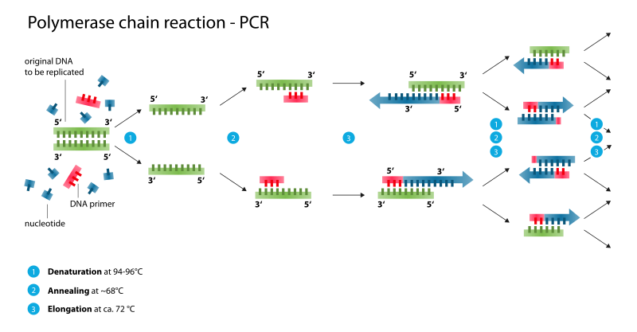
Techniques in Biotechnology
Human Genome
Biotechnology and DNA
Polymerase Chain Reaction (PCR)

Slide 2

Date: | Human Biology Year 12 ATAR
Do Now Get out your equipment and textbook. Lesson Agenda 1: Intro to Biotechnology 2: PCR 3: Start on the Review Worksheet 4: Lesson summary and wind-up Suggested Study Complete review worksheet, then mark and correct using the answer key on Connect. NEXT LESSON DNA Sequencing | Learning Aims Define “biotechnology” and give some examples Describe the Human Genome Project and outline potential benefits Understand the structure of DNA Describe the purpose of PCR Outline how PCR technique was developed List the materials used in PCR and describe their functions Describe the PCR cycle in detail List applications of PCR
 | Key Vocabulary Polymerase Chain Reaction (PCR) Taq Polymerase Thermus aquaticus Annealing Primer Denaturation Extension

Slide 3
Biotechnology
Use of technology to manipulate organisms for human advantage
Can be simple:
Using yeast to make bread
Cultures for yoghurt and cheese
Can be complex and modern:
Genetic testing
Gene manipulation
Cell replacement therapies
Tissue engineering
Learning Aim: Define Biotechnology and give some examples

Slide 4
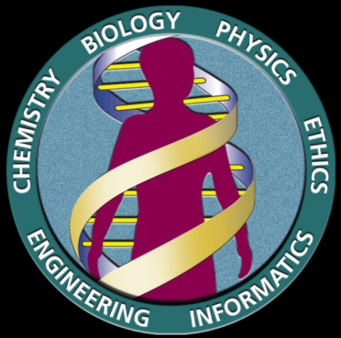
The Human Genome Project
Process of mapping gene locations on chromosomes
Project established in 1990
Complete sequence of nucleotides for the 21000 genes in the human genome
Project completed in 2003, but data analysis will take much longer
Potential benefits include:
Identification of location of faulty genes on chromosomes
For diagnosis
For replacement using recombinant DNA technology or tissue engineering
Monitoring of gene expression – pathways of genetic disease
Genetic testing for disease risk and recommendations to avoid
Learning Aim: Describe the Human Genome Project and outline potential benefits

Slide 5
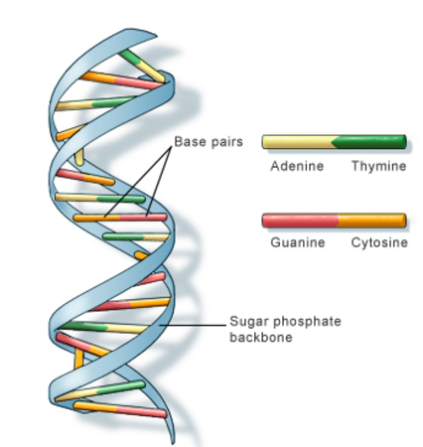
DNA reminder
DNA: Deoxyribonucleic acid
Found in cells of all organisms
Nucleus and mitochondria
Sugar and phosphate backbone
Nitrogen base “rungs”
4 bases:
Adenine (A)
Thymine (T)
Cytosine (C)
Guanine (G)
Order of bases codes for protein production
Learning Aim: Understand the structure of DNA

Slide 6
Polymerase Chain Reaction (PCR)
Generates millions of copies of DNA from a small sample
Shortens the time taken to sequence DNA
Each gene of interest can be amplified so easier to work with
Quicker detection of disease mutations eg Cystic fibrosis
Can detect viral diseases early in infection
Can get a large amount of DNA from a very small biological sample eg fossils, single drop of blood.
Learning Aim: Describe the purpose of PCR

Slide 7
Development of PCR
Developed by Kary Mullis, who was awarded a Nobel Prize for Chemistry, in 1993
Human DNA polymerase assists replication BUT is denatured during heating to separate strands of DNA.
Mullis used heat-stable DNA polymerase from the bacterium Thermus aquaticus, which inhabits very hot aquatic environments.
This heat stable DNA polymerase is called Taq polymerase, after the bacterium.
Taq polymerase enzyme is most active at around 70ºC (a temp at which human DNA polymerase would denature). This means it stays stable through the cycles of temperature change in PCR.
Learning Aim: Outline how the PCR technique was developed.

Slide 8
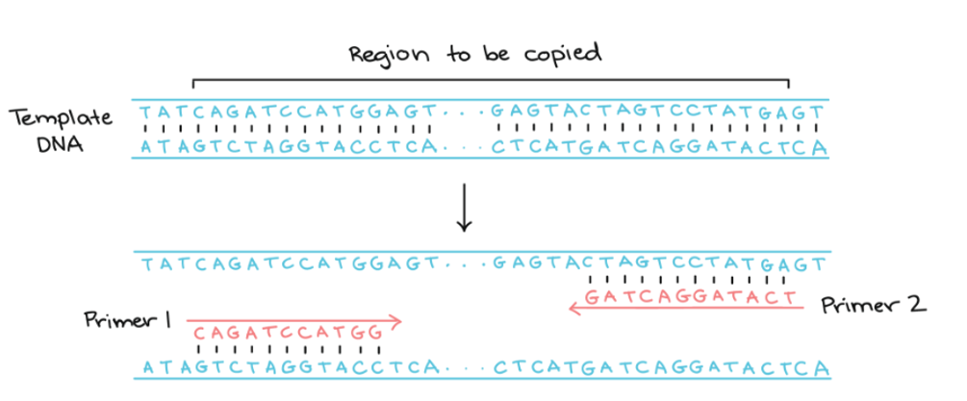
PCR: Primers
Short pieces of single strand DNA, around 20 nucleotides in length.
Used as an attachment point for Taq polymerase to begin to add new nucleotides.
Two primers used in PCR, one opposite ends of each strand of the DNA sample of interest.
Learning Aim: Outline the ingredients of PCR and their functions

Slide 9
PCR Ingredients and Steps
PCR is a technique to make many copies of a DNA sample.
Key ingredients:
The DNA sample of interest (as a template)
Thermostable DNA polymerase (Taq polymerase)
DNA Primers specifically for the DNA sample of interest
Nucleotides to attach to the template strand
In PCR, the reaction is repeatedly cycled through a series of temperature changes:
1: Denaturation (96ºC): Heat separates the DNA strands to provide single stranded templates.
Note: the Taq polymerase is heat stable so it doesn’t denature and can be used again in the next cycle.
2: Annealing (55-65ºC): The reaction is cooled so the primers can anneal (bind) to the template DNA to create a starting point for nucleotides to be added.
3: Extension (72ºC): The temperature is raised so that Taq polymerase can add new nucleotides to the primer, extending the copy of the template strand.
Learning Aim: Outline the ingredients of PCR and their functions
Learning Aim: Describe the PCR cycle in detail

Slide 10
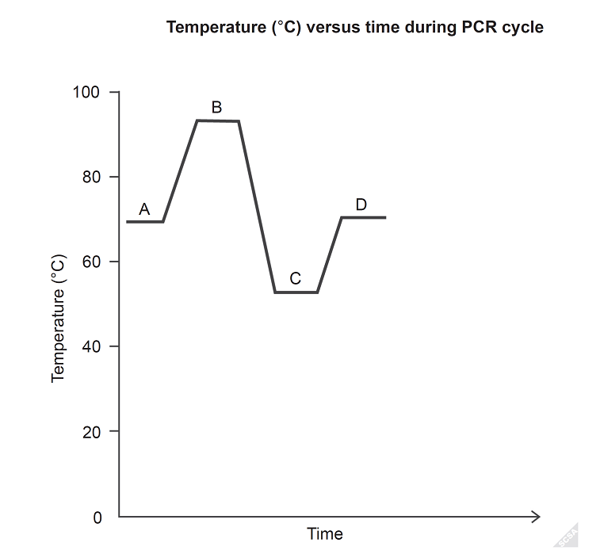
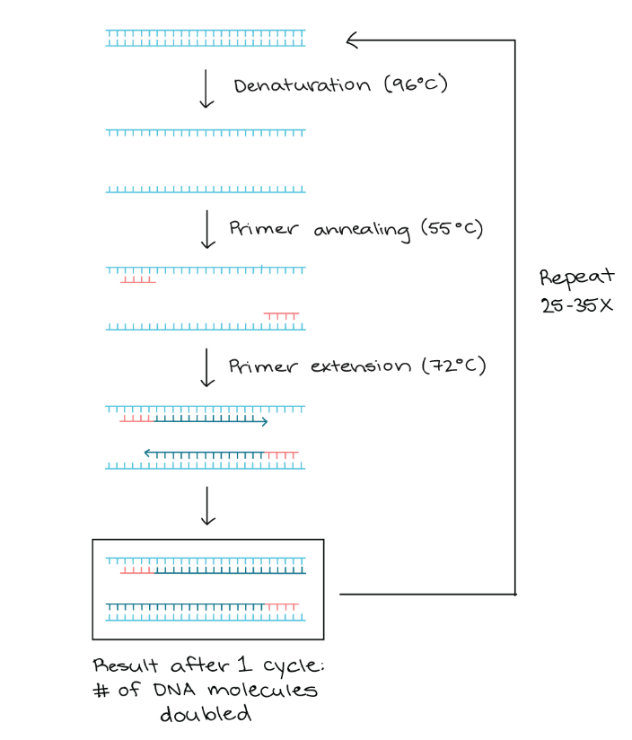
PCR Cycle
A, D: extension/strand synthesis
B: Denaturation
C: Primer Annealing
Learning Aim: Describe the PCR cycle in detail

Slide 11
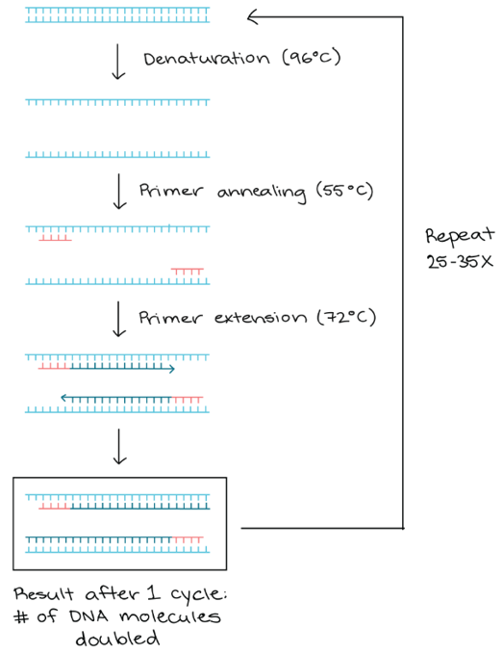
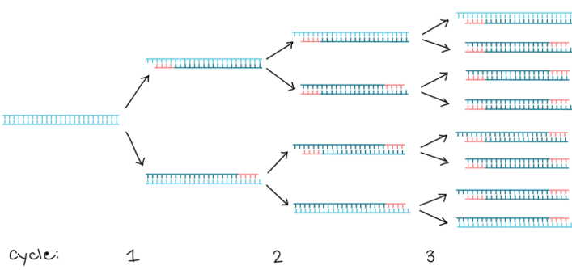
PCR Cycling
Cycle repeats 25 -35x on average. The number of DNA molecules doubles each time. Process takes 2-4 hours.
Can go from a very small sample to billions of copies in this time.
This is because:
The Taq polymerase remains functional for the entire process, through the many temperature changes
Each cycle, all of the DNA available is denatured, so each cycle the template strands available doubles.
Learning Aim: Describe the PCR cycle in detail

Slide 12
https://www.youtube.com/watch?v=iQsu3Kz9NYo

Slide 13
Applications of PCR
Amplifies DNA samples for:
Forensic identification using gel electrophoresis
Cloning to use in recombinant DNA technology
Sequencing of DNA to identify genetic diseases
To test for the presence of bacterial or viral DNA/RNA to diagnose disease (eg COVID!)
Learning Aim: List applications of PCR

